Slide 1
Project 1
Stock Market

Slide 2
Problem statement
Client is looking to invest in different sector and selected the Aerospace & Defense
What company should the client invest in?

Slide 3
data
Companies analyzed:
RTX (Raytheon)
GD (General Dynamics)
LMT (Lockheed)
SPY500
All selected companies had outstanding dividend payout last year.
Sources:
https://data.nasdaq.com
https://api.marketstack.com

Slide 4
Percentage change
Each month from September 2023 to January 2024
Overall percentage change
September 2023: SPY: -3.43%, RTX: -4.01%, LMT: -4.95%, GD: -1.42%
October 2023: SPY: -1.97%, RTX: +13.45%, LMT: +11.17%, GD: +8.94%
November 2023: SPY: +8.87%, RTX: -0.63%, LMT: -1.88%, GD: +2.05%
December 2023: SPY: +4.29%, RTX: +3.26%, LMT: +1.08%, GD: +5.09%
January 2024: SPY: +2.27%, RTX: +8.41%, LMT: -5.48%, GD: +2.05%
SPY: -21.05%
RTX: -38.48%
LMT: -24.72%
GD: -25.10%

Slide 5
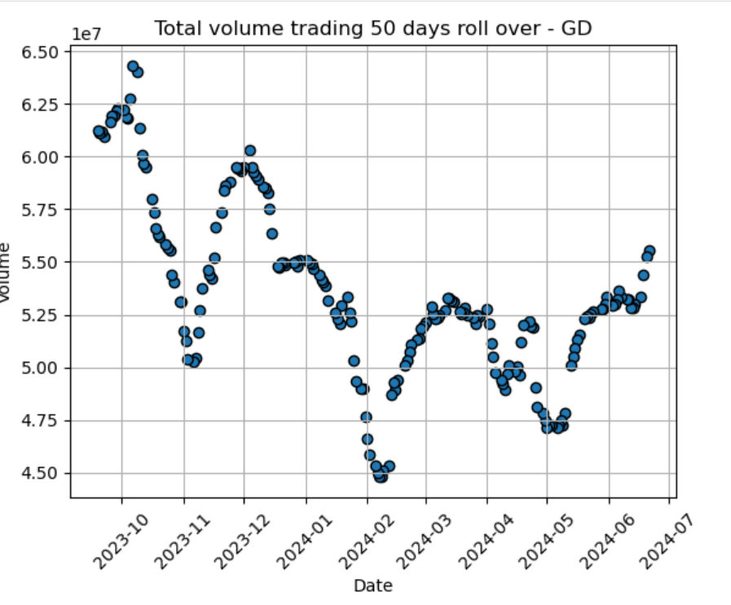
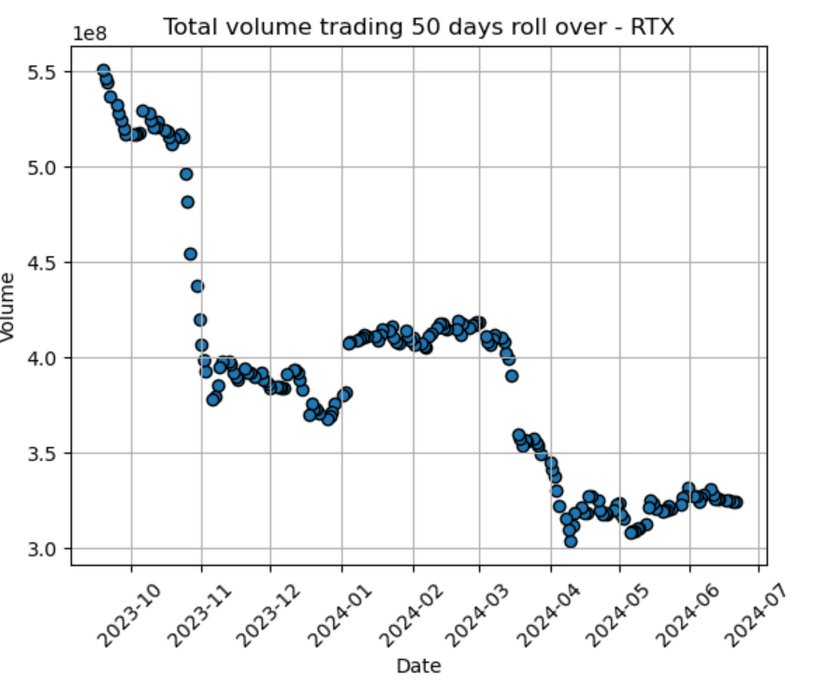
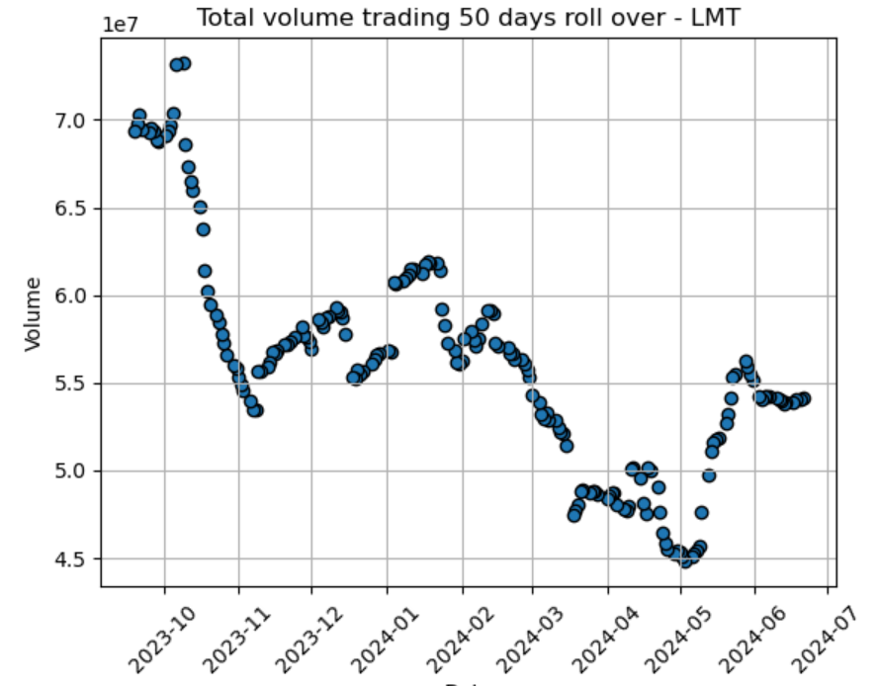
Total Volume trading

Slide 6
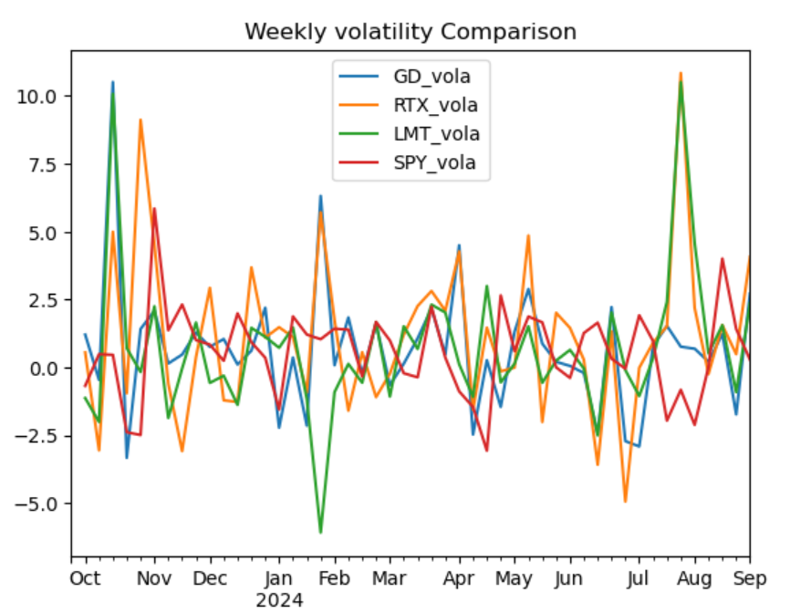
Weekly volatility comparison

Slide 7
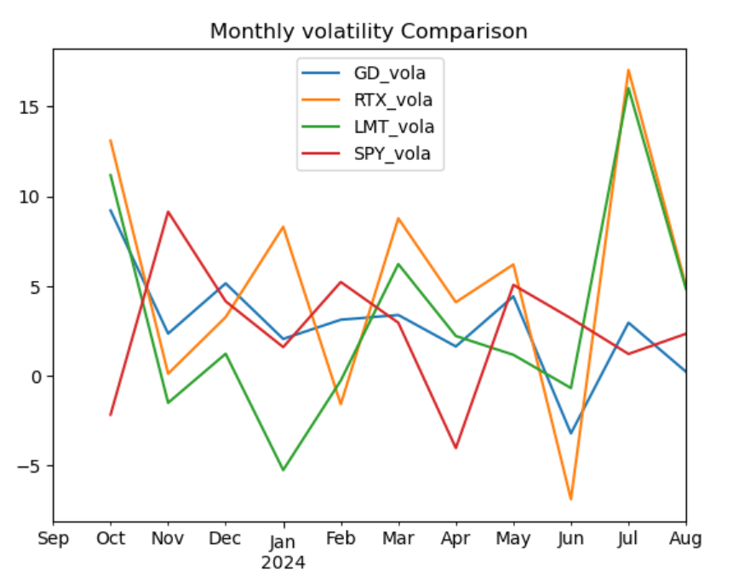
monthly volatility comparison

Slide 8
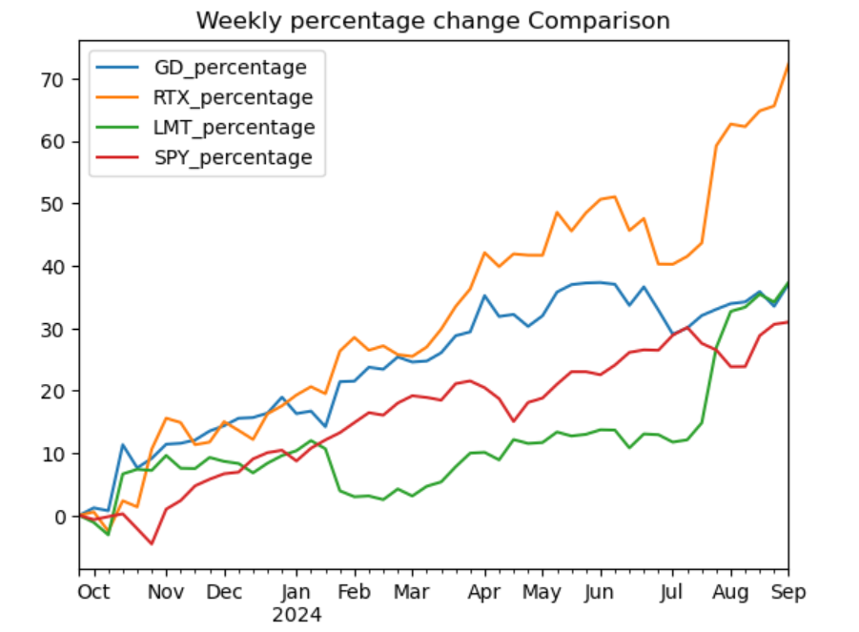
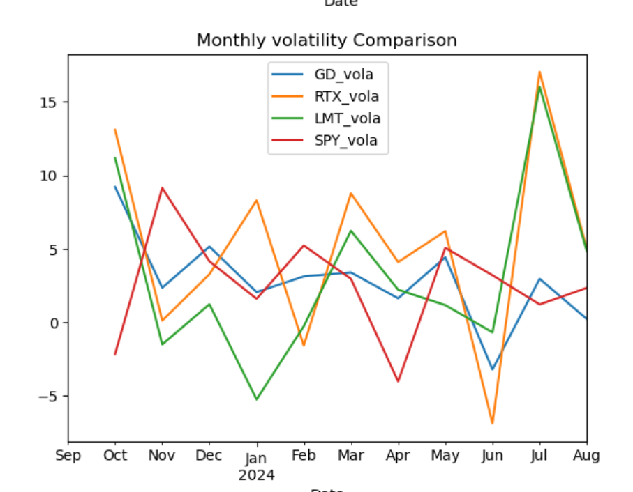
Rate of change (roc)

Slide 9
CONCLUSION
We recommend to invest in GD (General Dynamics), the company has the lowest risk. Low price volatility and high total volume trading.

